Slide 1
Template Matching and Image Pyramid
Dr. Rongzhong Li
CSC391/691 Fall 2016

Slide 2
Task: Find a Phrase in String
How to find a certain phrase in a string?
Example: Look for segment “ever” in “ThisIsA RandomSentenceGeneratedByRongzhongInFever”.
ThisIsARandomSentenceGeneratedByRongzhongInFever
ener ever
| : | | | | | |
ever ever
Look for “every”?

Slide 3
Basic Procedure
Use the phrase as a sliding window
Slide through the sentence and find the best match
Define “best match”
Similarity / Correlation / Distance
Define distance measure
Locate the segment with higher matching probability / smaller difference
Notes:
Single value measure

Slide 4
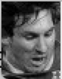
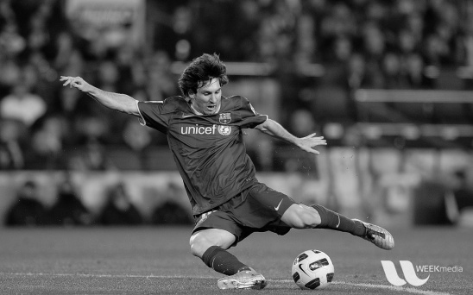
Task: Find a Template in Image

Slide 5
Basic Procedure
Use the template as a sliding window
Slide through the image and find the best match
Define “best match”
Similarity / Correlation / Distance
Define distance measure
Locate the region with higher matching probability / smaller difference
Notes:
Single value measure

Slide 6
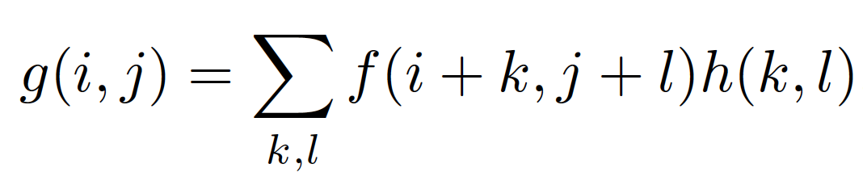
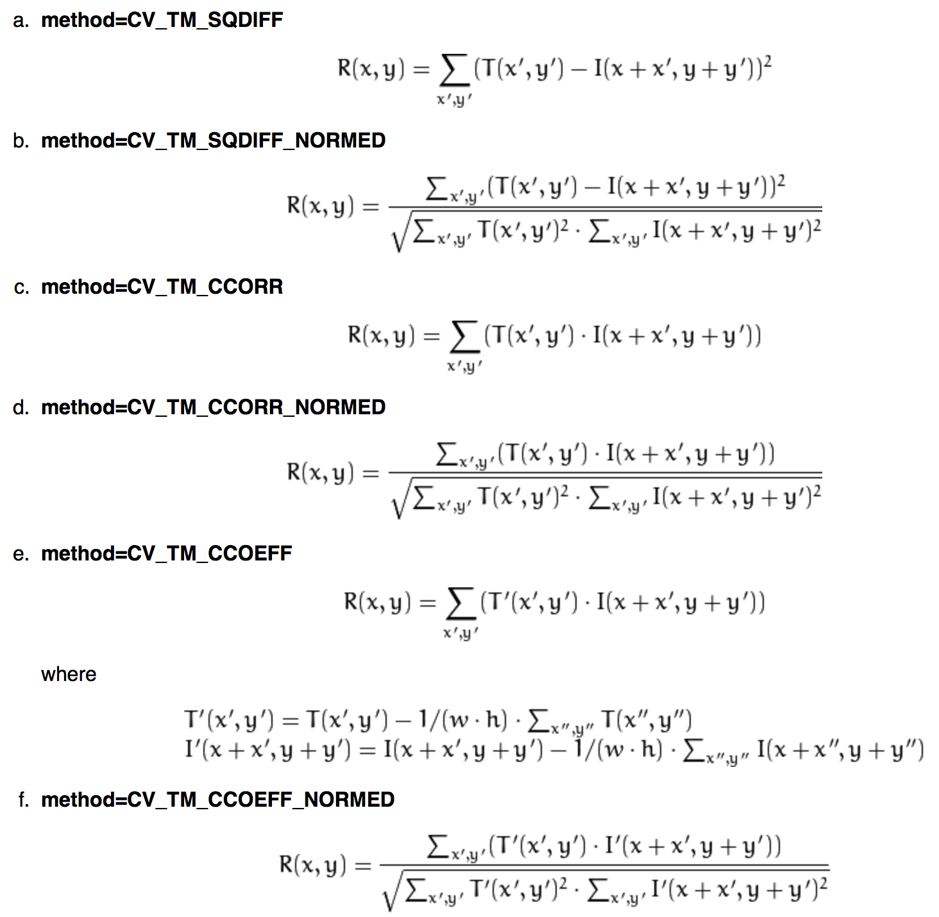
Distance Measures
General form of filters
cv2.filter2D(src, …, kernel,…)
cv2.matchTemplate(img, template, method)
Notes:
Intensity change solved by normalization
Documentation: http://docs.opencv.org/2.4/doc/tutorials/imgproc/histograms/template_matching/template_matching.html

Slide 7
Distance Measures

Slide 8
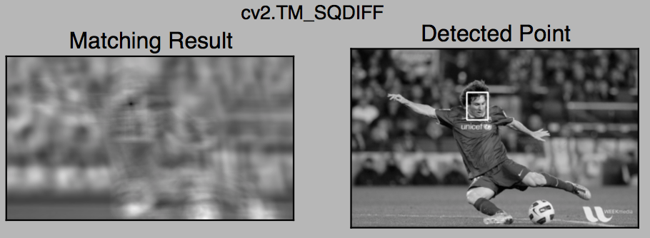
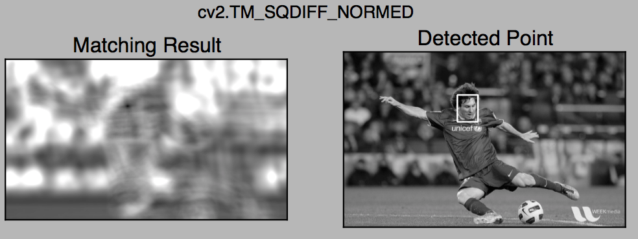
Example: Square Difference

Slide 9
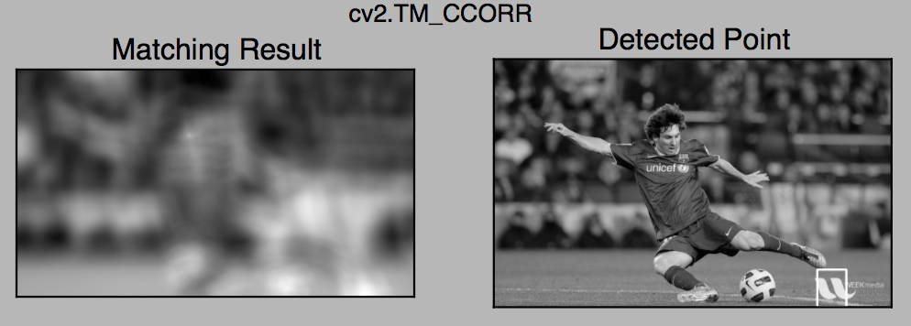
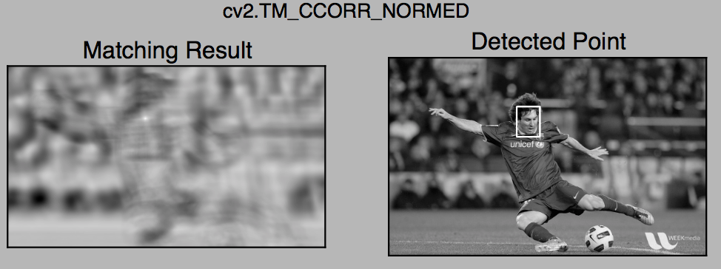
Example: Cross Correlation

Slide 10
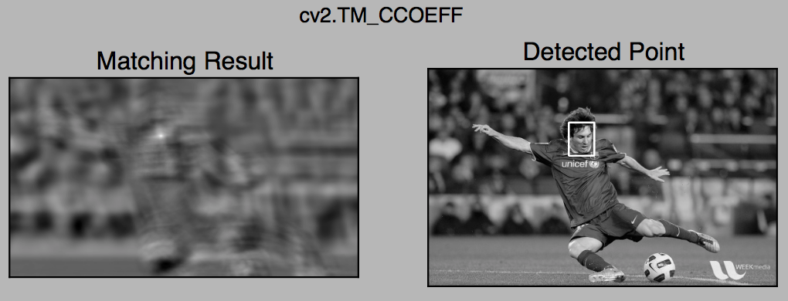
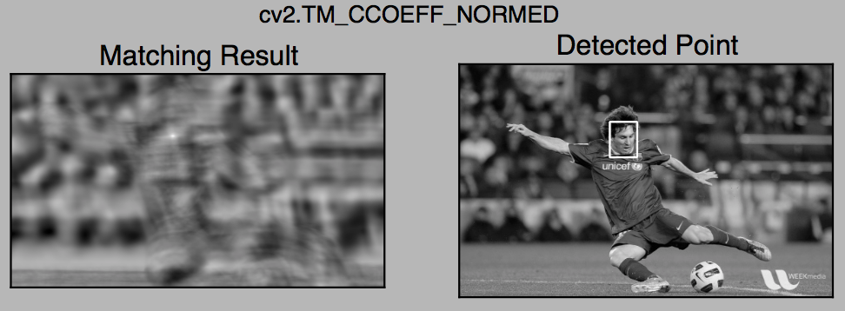
Example: Cross Coefficient

Slide 11
Problems Unsolved
Scale
Rotation
Transformation
Aberration
Variation

Slide 12
Acceleration
Filter on frequency domain
f*g O(n²)
F(f*g)=F(f) · F(g)
=> f*g=F⁻¹( F(f) · F(g) ) O(n Log n)
Use image pyramid
Search low resolution image on large scale
Search high resolution image on small scale

Slide 13
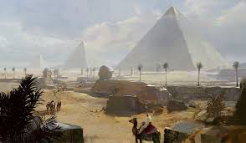
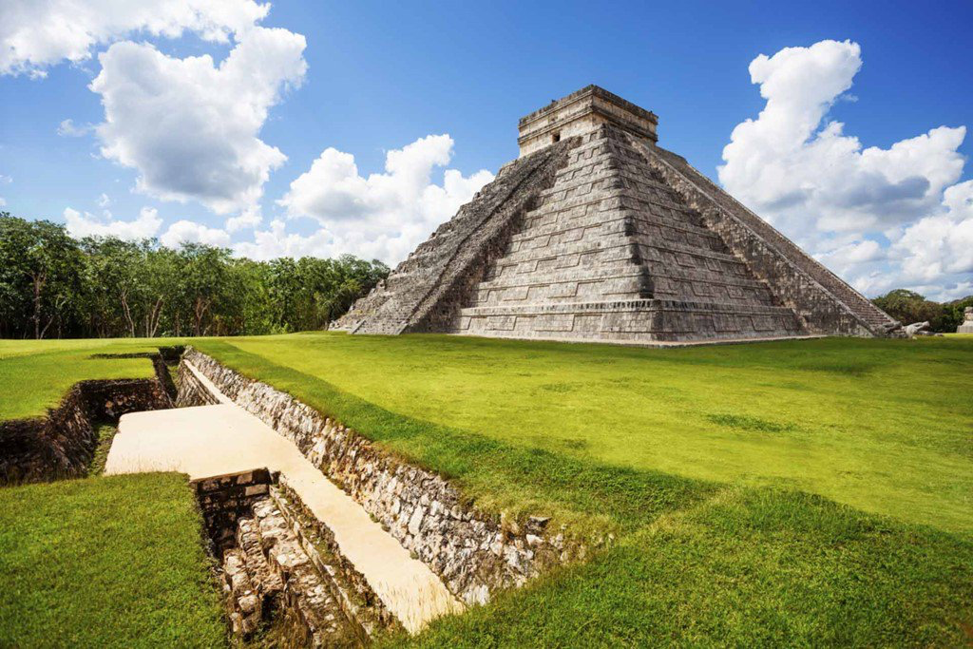
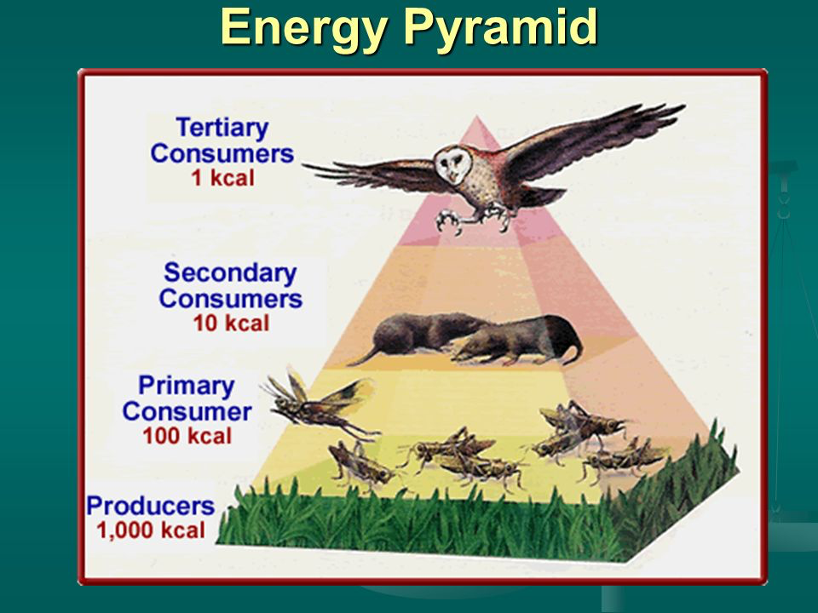
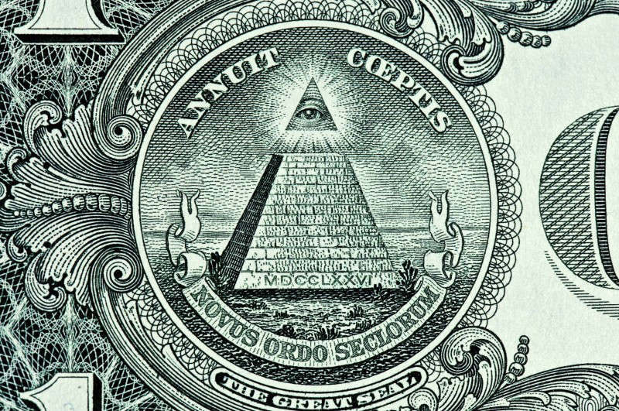
Images of Pyramids

Slide 14
Up-Sampling/Interpolation
Increase the resolution of an image

Slide 15
Down-Sampling/Decimation
Reduce the resolution of an image

Slide 16

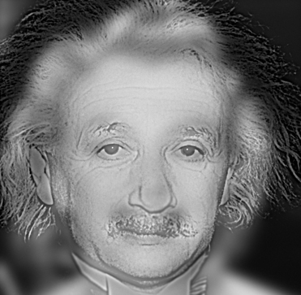
Applications
Multi-scale representation of features
Interlacing
Hybrid image

Slide 17
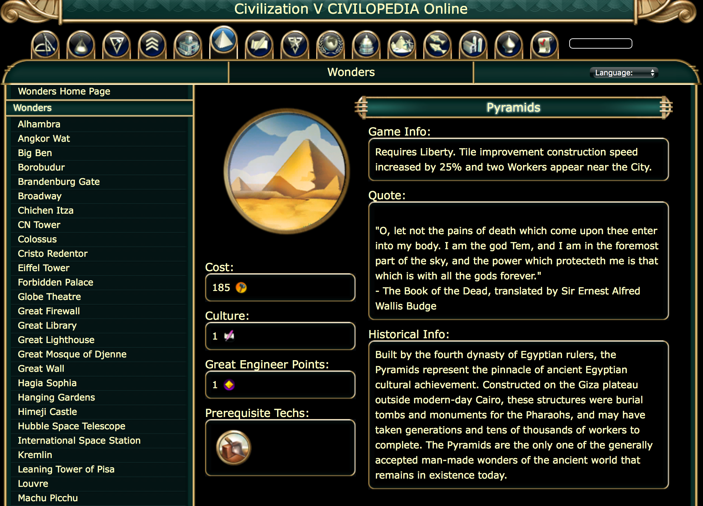
Civilopedia!

